Slide 1


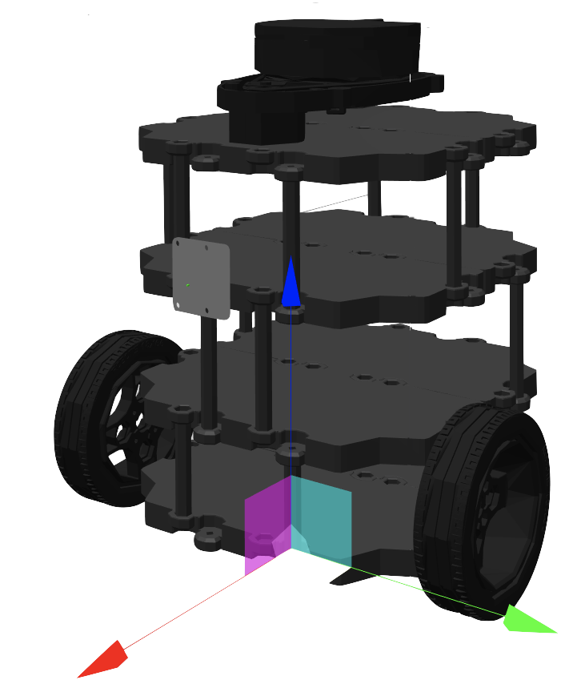

Multi-Sensor Fusion and Tracking
Supervised by
Prof. Omar TAHRI
Presented by:
Reetika GAUTAM
SEIKH Mohammed Basharat Mones

Slide 2
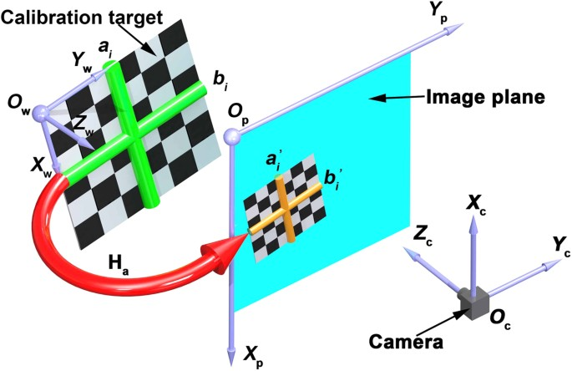
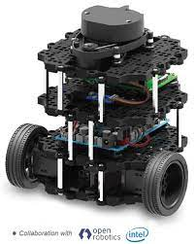
Content:
CONCLUSION
References
Problem statement
Basic architecture of our model
DEMO VIDEO
Obstacle avoidance
Timeline
Organization
Difficulties and drawbacks

Slide 3
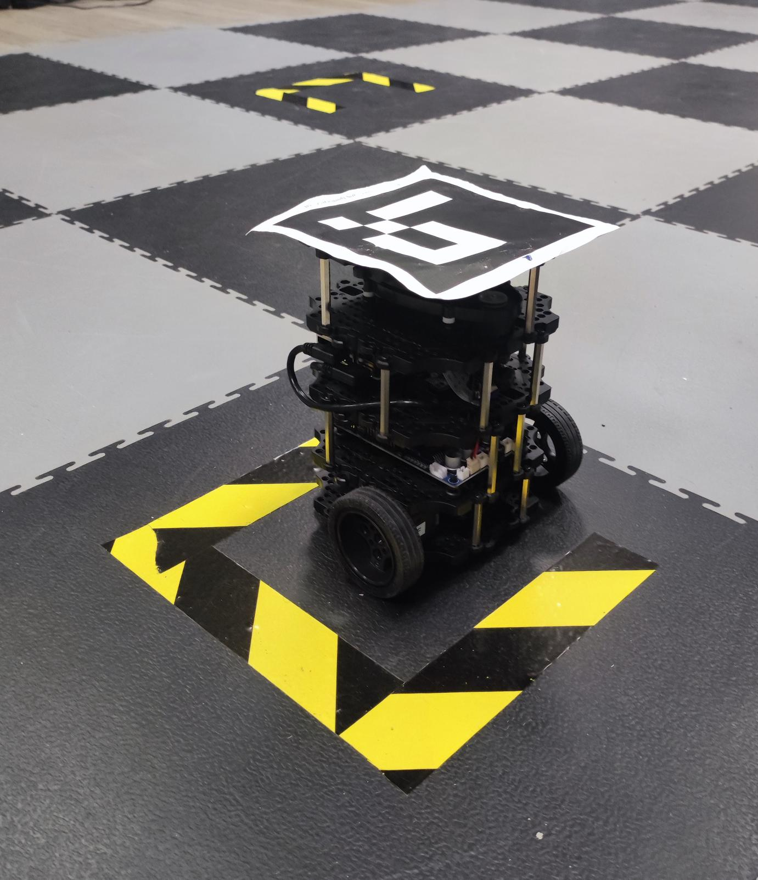
Introduction and problem statement
Visual servoing is a control technique used in robotics to control the motion of a robot using visual feedback from a camera.
Move the robot to the target positin with parking.
Move the robot to the target positin with obstacle.
Notes:
Visual servoing is a control technique used in robotics to control the motion of a robot using visual feedback from a camera.
For our project we will demontrate a real time visual servoing performed on TurtleBot3- Burger to follow a defined target from an UEYE-camera using the configuration (Eye-to-hand) configuration uisng ROS noetic :
The first objective is to move the robot from an initial position to a Target position considering the target orientation (Parking).
The second task is to make the robot follow the optimal path to target by avoiding the obstacle encountered on it's way.

Slide 4
Timeline
Ueye_cam
First we find the right driver to visualize the video feed UEYE_CAM .
Camera calibration
To estimate the intrinsic and extrinsic parameters of UEYE we calibrate the camera.
Using aruco markers to estimate the pose of the robot and target at any given point and publish it as ROS topic.
Control
ROS integration
Integrating our algorithm with ROS so every node can communicate.
Defining an optimized control for robot to reach the target with f/w and rotational gains.
Pose Estimation
Obstacle avoidance
Use lidar data for avoiding obstacle.

Slide 5

Organization:
Introduction with ROS ueye _cam and TurtleBot3
Exploring techniques to estimate pose of the robot.
Designing a control loop for the robot.
Parking of the robot.
Obstacle avoidance from the lidar data.
Notes:
Pour l'organisation du travail J'ai passé le tiers de travail à explorer niryo et le logiciel, ensuite une bonne partie du temps était consacré au ROS et Python avec tous les obstacles que j'ai confrontés. Et en finale la partie documentation qui a pris une bonne dizaine d'heure aussi. Pour la documentation tout est sur Github, Je continue également à peaufiner cette documentation vue qu'on a pas eu assez du temps et que je savais pas utiliser github avant.

Slide 6
Architecture of our model:
Camera calibration
initial and target pose estimation
Control system
Integration of ROS

Slide 7
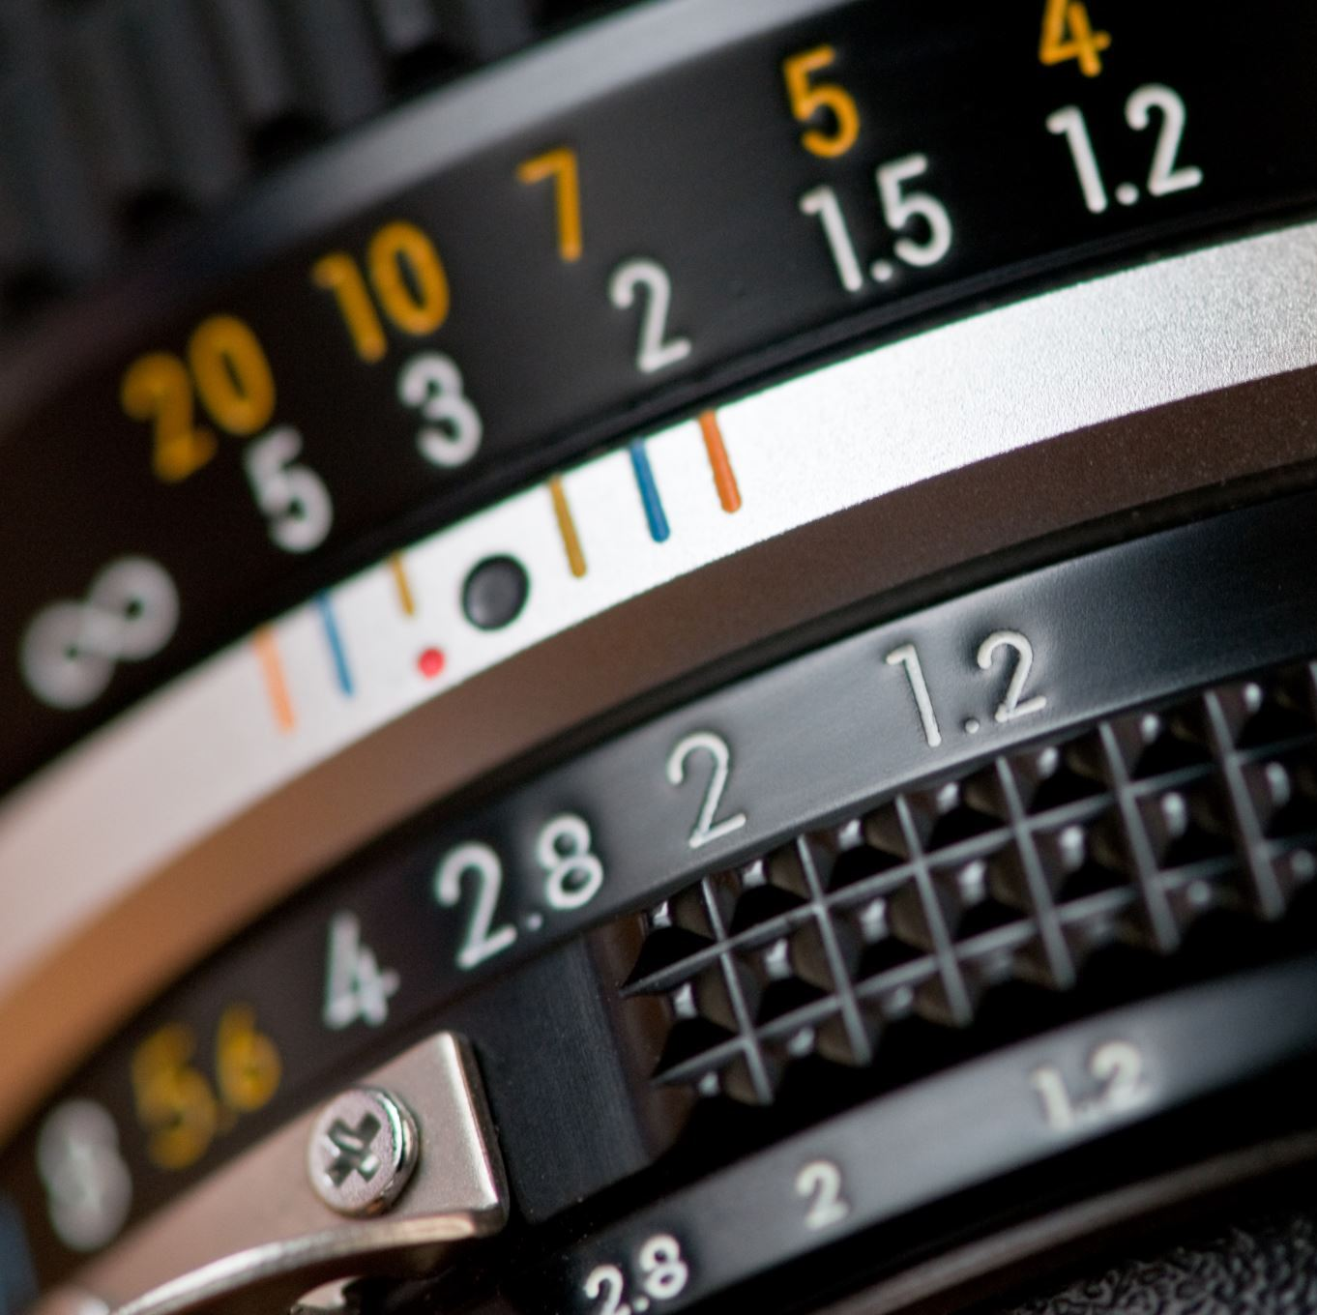
Camera calibration
Camera Calibration is the process of estimating the intrinsic and extrinsic parameters.
Intrinsic parameters refer to the internal characteristics of the camera, such as focal length, tilt, distortion, and image center
We use the intrinsic parameters to estimate the pose of the marker.

Slide 8
3D Pose estimation
Detecting the robot by aruco package
Get the 3D pose of the marker

Slide 9
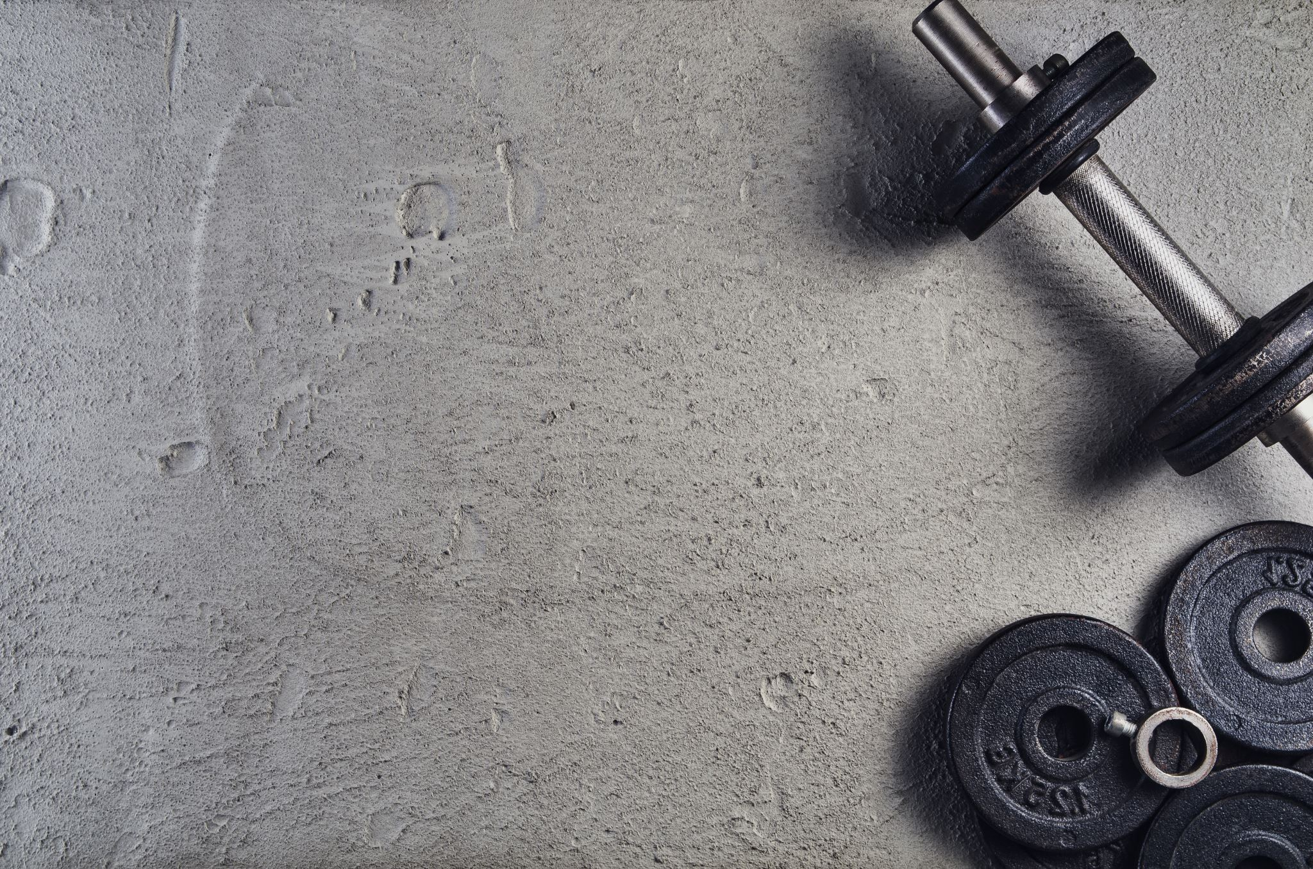
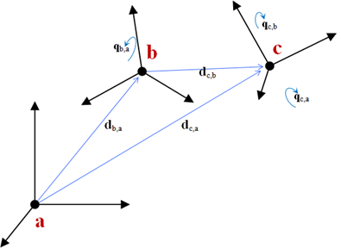
Frame Transformation
Our goal is to get the transfromation matrix of the target in robots frame.

Slide 10
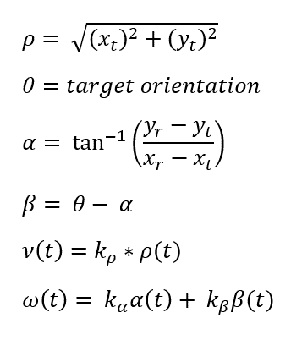
Control system
After getting the position of the target in the robot frame, we compute the velocities in order to send it to the robot, so it reaches the target.
The control is the forward and rotational speed that minimize the error between the current position and target position.
Using these equations to compute the velocity

Slide 11
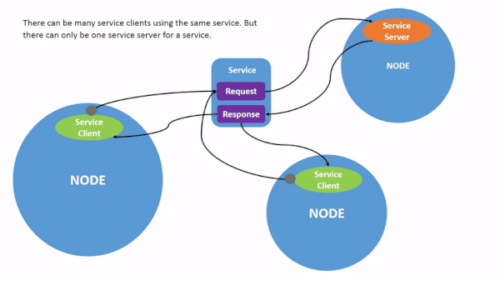
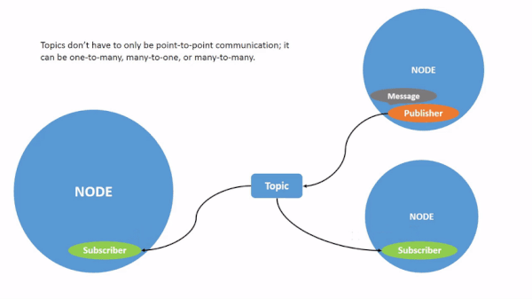
ROS
Publishing velocities in ROS using cmd_vel
Publish the pose for two different aruco markers detected.
Subscribe to the two topics to get the pose of robot and target.
Notes:
Un ensemble de bibliothèque et des outils pour aider a créer des applications de robot.

Slide 12
Control loop
Detecting the robot and the target
Pose of the robot and target
Compute the velocity
Publish velocity to the robot
Robot move

Slide 13
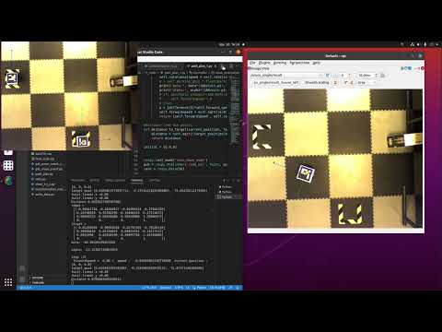
Demo Video Parking
Here we are hard coding the target position in different orientations to check for the parking.

Slide 14
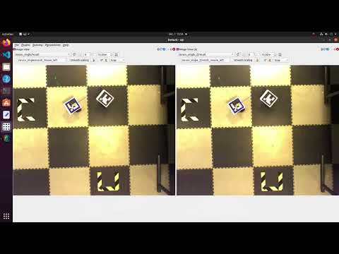
Visual Servoing
We See here that our Robot with marker ID (25 ) is able to follow the target (marker ID 701) at all instance of time in the camera frame.

Slide 15
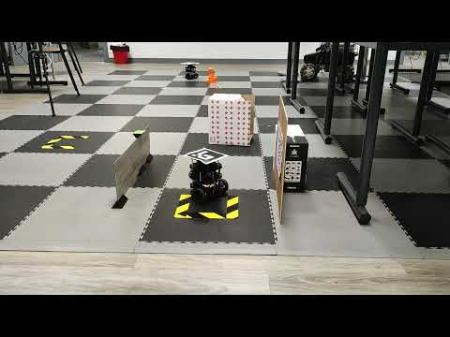
Obstacle Avoidance
Detection of an obstacle is an important part of any self-driving robot. Lidar is a very reliable device to calculate distance from nearby field within its detectable range. The lidar in turrtlebot3 has a range of 120 ~ 3,500mm.

Slide 16
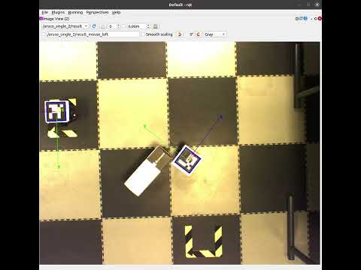
Obstacle Avoidance
Here we see that our model is successfully able to avoid the obstacle when it is in the range of 0.17 to 0.3

Slide 17
Challenges
Ambiguity in the lidar data
Validating that the estimated pose is correct
Getting data in proper manner
Lag in data
Too many zeros
Position of ArUco marker in z-axis
The orientation of the pose
Properly converting the quaternion into euler

Slide 18
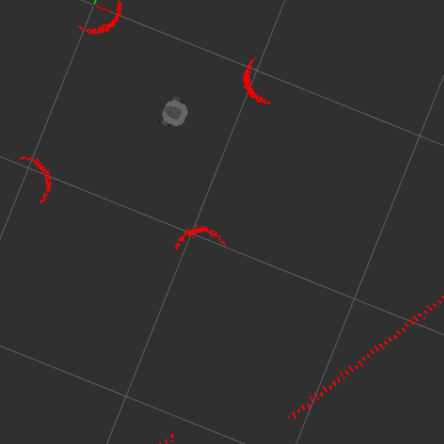
DRAWBACKS
Lidar used in TurtleBot3
Sensitive to changes in lighting conditions and can be computationally intensive
Which can limit its use in real-time applications

Slide 19
Conclusion
Overall, the conclusion of visual servoing as a control method is that it can be a powerful tool for robot manipulation, but it is not a one-size-fits-all solution and should be carefully(such as environments where the visual information is limited or unreliable) considered for each specific application.
The project allowed us to take on hand several important robotic skills, image processing, visual servoing, path planning, interpretation of the result, frame transformation, and soft skills as well.

Slide 20

References
ROS TurtleBot3 Basics ROS Wiki ROS Basics course ROS perception course

Slide 21
